Slide 1
Introduction to Accessibility

Slide 2
Agenda
Who am I?
What is Accessibility?
Models of Disability
Accessibility Categories
Why does Accessibility matter?
Who is responsible?
What can you do?
Tools and Resources

Slide 3

Who am I?
Erissa Duvall
Formerly 3 years in IT at American Printing House for the Blind
Currently:
Part-Time QA for GoodMaps
Accessibility Engineer for CVS Health
Volunteer mentor with Code Louisville
DHS Trusted Tester Certificate

Slide 4



What is Accessibility?
Accessibility
Assistive Technology
A11y
Disability
Notes:
Accessibility – how well can your product be used by people of all abilities?
Disability – A disability is basically a mismatch in interaction between a person’s body and the features of their environment in which they live.
Accessible Technology (AT) - is any item, piece of equipment, software program, or product that is used to increase, maintain, or improve the functional capabilities of people with disabilities.
A11y – a commonly accepted numeronym for Accessibility that stands for the fact that Accessibility starts with an “A”, ends with a “Y” and has 11 characters in between.

Slide 5
Models of Disability
Medical
Social
Notes:
Jeremy Andrew Davis has awesome videos describing the differences between the Social and Medical models on Instagram and LinkedIn:
JeremyAndrewDavis (@jeremyandrewdavis) • Instagram photos and videos
(8) Jeremy Andrew Davis | LinkedIn
(63) Cinema Therapy - YouTube

Slide 6
Accessibility categories
Disability Types
Time
Temporary
Permanent
Visibility
Visible
Invisible
Hearing
Vision
Mobility
Comprehension
Situational

Slide 7
Accessibility Guidelines
WCAG
ATAG
UAAG
Notes:
Jeremy Andrew Davis has awesome videos describing the differences between the Social and Medical models on Instagram and LinkedIn:
JeremyAndrewDavis (@jeremyandrewdavis) • Instagram photos and videos
(8) Jeremy Andrew Davis | LinkedIn
(63) Cinema Therapy - YouTube

Slide 8
Accessibility Regulations
ADA
Section 508
AODA
Notes:
Jeremy Andrew Davis has awesome videos describing the differences between the Social and Medical models on Instagram and LinkedIn:
JeremyAndrewDavis (@jeremyandrewdavis) • Instagram photos and videos
(8) Jeremy Andrew Davis | LinkedIn
(63) Cinema Therapy - YouTube

Slide 9
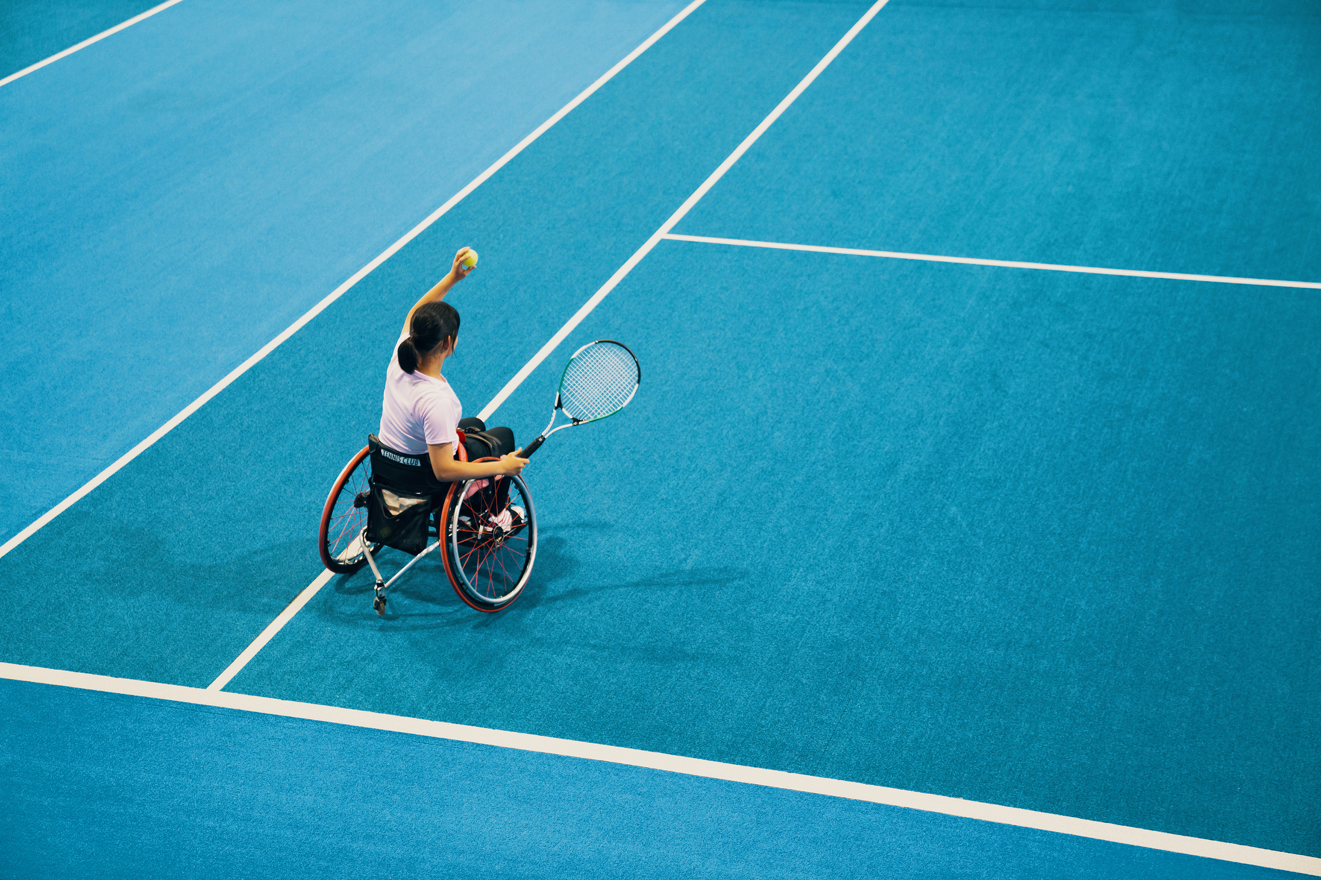

Why Does Accessibility matter?
Helps everyone
Lack of a11y = discrimination
Helps with retention / diversity
Expensive financially and socially
Can exclude a lot of customers without it
Notes:
Helps everyone
Make things better for all, yourselves included
Lack of a11y = discrimination
Unfairly block people from personal and professional opportunities
Unfairly block people from information
Isolate people
Helps with retention / diversity
Helps people feel welcome
Helps people feel seen/supported
Expensive financially and socially
Expensive lawsuits and fines
Loss of social standing / respect
You are not getting an exemption, just ask Dominos
Can exclude a lot of customers without it
CDC estimates that around 26% of people in the US have a disability

Slide 10
Who is responsible?
Everyone

Slide 11
What can you do?
Shift-left
Listen
Speak up
Respectful, people-first language
Follow coding best practices
W3C
PEP (Python)
WAI-ARIA
DON’T use an accessibility overlay.
Learn more at Overlay Fact Sheet.

Slide 12
Tools and resources
Accessibility Insights – A Accessibility testing tool made by Microsoft
Has browser extension and desktop application versions
Also have the option to include the automated tests in CI/CD
DON’T depend on automated tests
NVDA – free, open-sourced screen reader
View keyboard shortcuts on at the Deque article entitled: NVDA Keyboard Shortcuts.
Narrator – screen reader built into Windows.
View keyboard shortcuts for Narrator in the Deque article entitled Narrator Keyboard Shortcuts.
Microsoft Accessibility on Twitter at @MSFTEnable and at on the Microsoft Accessibility page.
Microsoft Accessibility Fundamentals course
ANDI – Bookmarklet developed by the Social Security Administration to aid in accessibility testing.
VGAR – Visa Global Accessibility Requirements
Section 508 ICT Testing Baseline for Web - This Baseline identifies the minimum requirements of any test process used to determine conformance of web content with the Revised Section 508 of the Rehabilitation Act of 1973, as amended (29 U.S.C. 794d).
Trusted Tester: Section 508 Conformance Test Process for Web – A standardized approach for manual inspection of web content for conformance with the revised Section 508 Standards.
IT Accessibility Laws and Policies | Policy & Management | Section508.gov – A page maintained by the GSA that provides information on some Accessibility related laws and policies
Web Accessibility Laws & Policies | WAI | W3C – Lists some United States governmental policies, regulations, and standards related to web accessibility.

Slide 13

Thank You!
Email: A11y@corgidev.com
Website: https://Corgidev.com/a11y.html
Mastodon: https://a11y.info/@CorgiDev
LinkedIn: https://www.linkedin.com/in/corgidev/

